Slide 1
Learning Based Pricing Strategies for Demand Response
Suhaila Shakiah
Electrical and Computer Engineering
New York University

Slide 2
Introduction
Changes in electric usage by end-use customers
Rising electricity prices
Incentives
System under jeopardy
High wholesale prices of electricity

Slide 3
Outline
Information with System Operator
Predicted probabilities
Linear model for predicted probability vs price
Optimizer
Optimizing both customer utility and system operator utility
Predicted power
Retail price
Wholesale price
Linear model for reduction vs price
Models
Bilevel optimization – Stackelberg game

Slide 4
Problem Definition
Leader – System Operator
Underlying customer preference
External factors:
Weather, time of day
Prices
Response
Prices
Follower - Consumer

Slide 5
Learning
Modelling customer behavior by accounting for various factors using techniques in machine learning
Incorporating learnt behavior into the optimization problem for pricing

Slide 6
Data
University of Massachusetts dataset for 10 homes for the year 2016
Power usage data: Power used in KWh
Weather data: Temperature, precipitation, humidity, rainfall
1 minute interval data converted to one hour intervals

Slide 7

Power consumption prediction
Data very non-linear
Support vector machines
Features:
- Day of week – month - hour of day – humidity – visibility – precipitation – past power usage
Total 8000 data points – 5700 training - 2300 testing

Slide 8
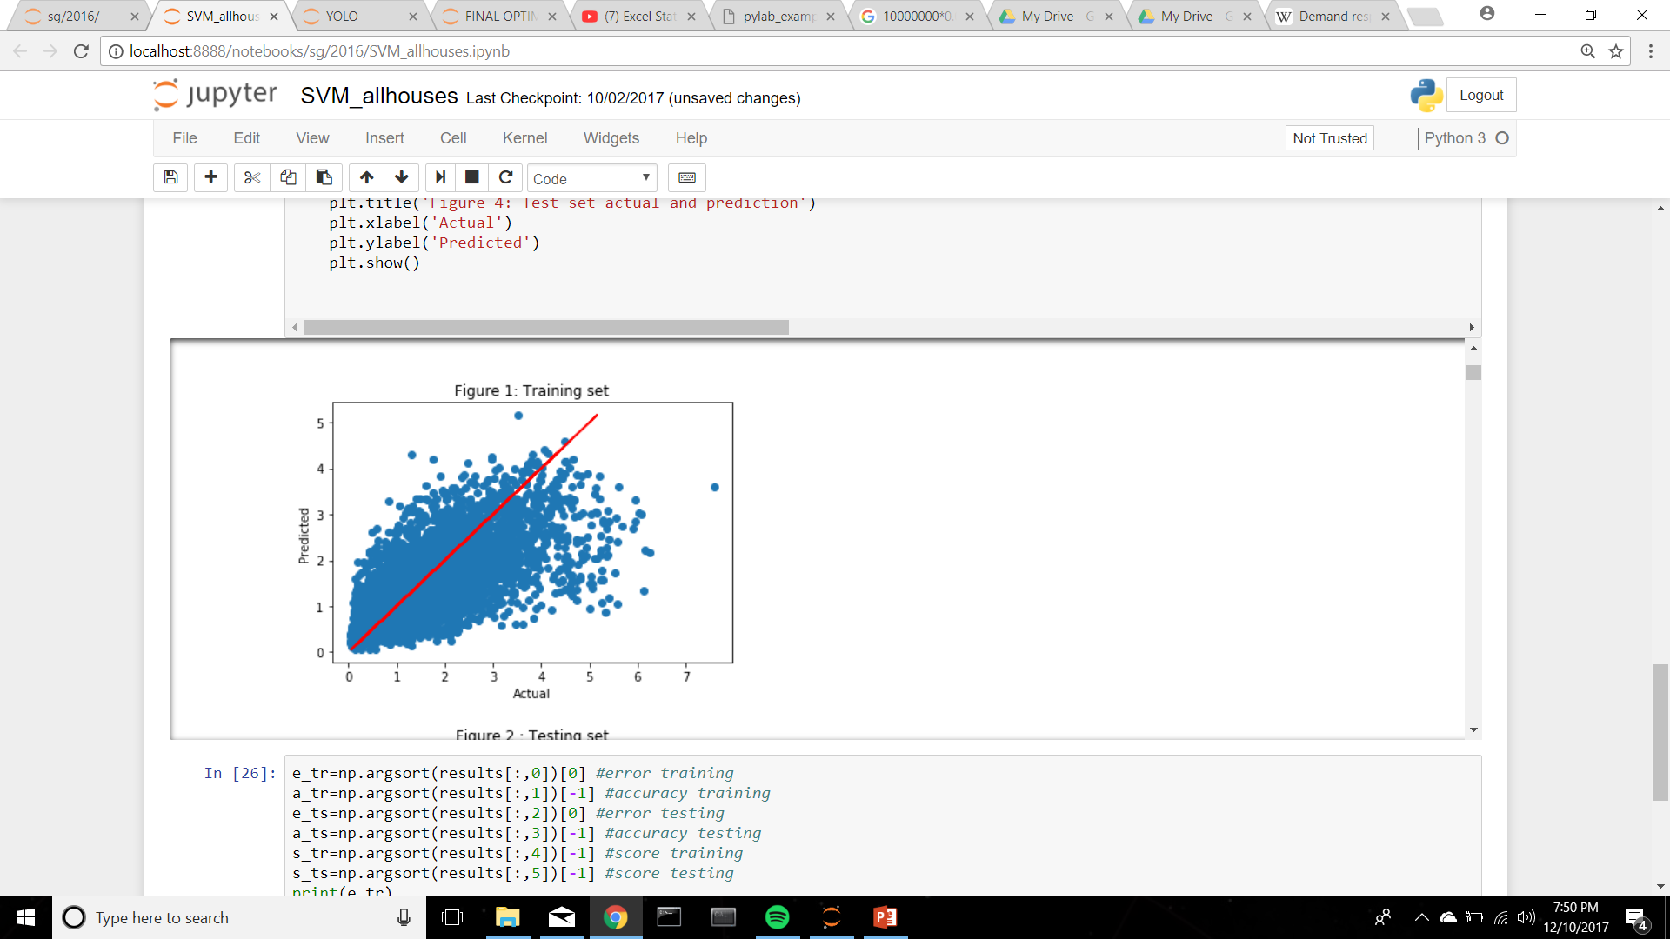
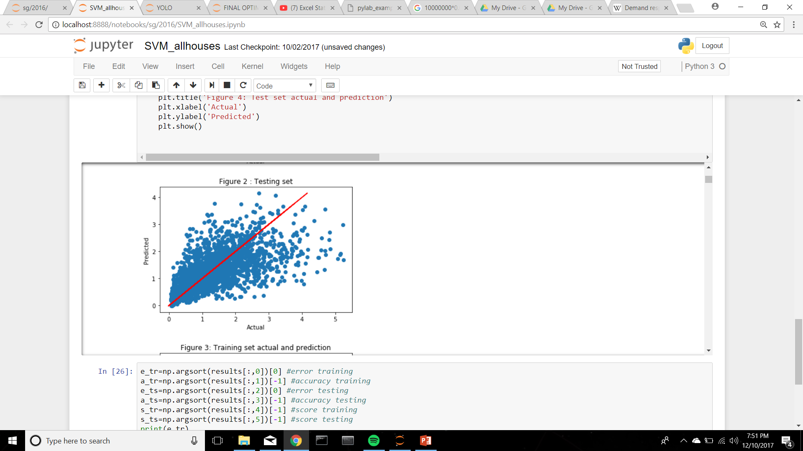
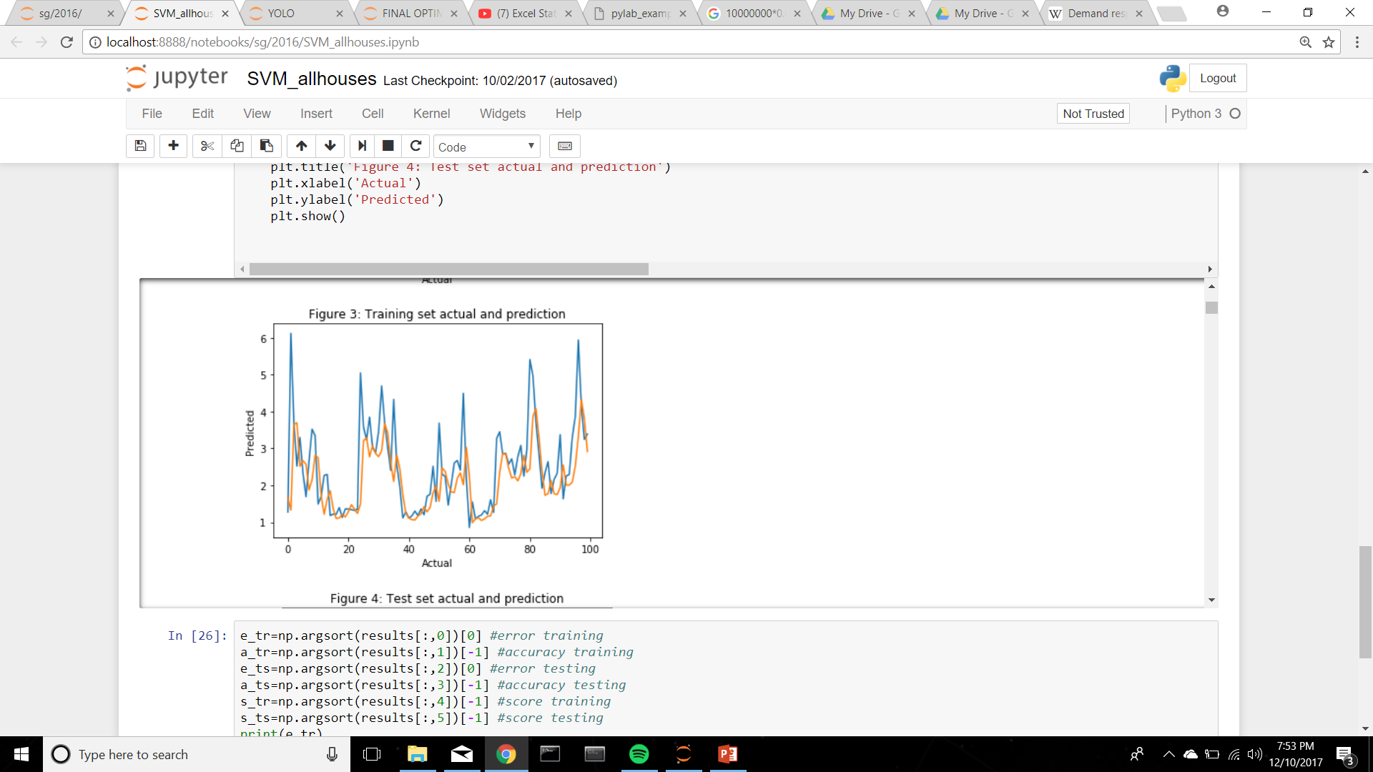
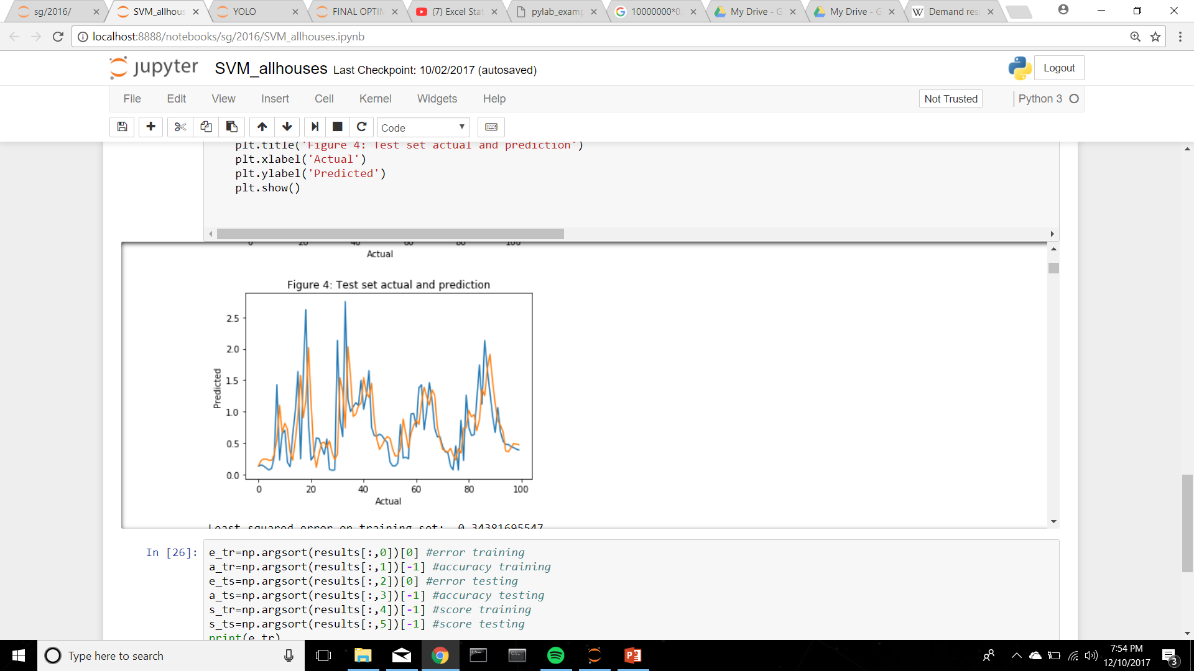
score training set: 0.675055213466 score test set: 0.788481487599

Slide 9
Synthetic data generation for demand response
Selected 10 houses
Synthetic power usage
Assigned a probability of positive response to each house
[0.32 0.5 0.31 0.78 0.44 0.84 0.09 0.06 0.12 0.3]
Significant reduction: m percentage of base-line power usage
Past performance parameter assigns m value
Random vector of m values between 0 and 1 assigned to each house based on past performance

Slide 10
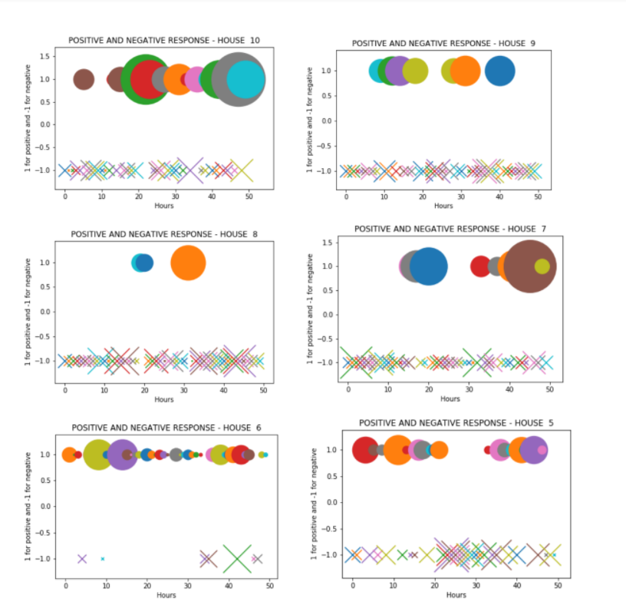

Slide 11
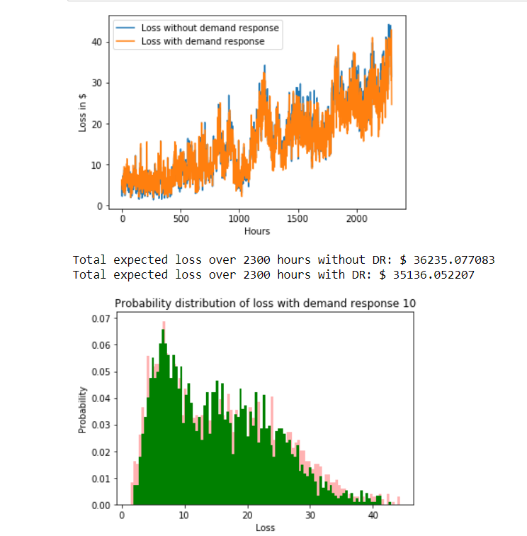

Slide 12
Predicting probability of positive response
Linear model for demand reduction and prices
Data: predicted power, weather data, prices
Logistic regression – Predicts probability of positive response
2300 data points from the power prediction (the algorithm is only as good as the predicted power) – 1000 training – 1300 testing

Slide 13
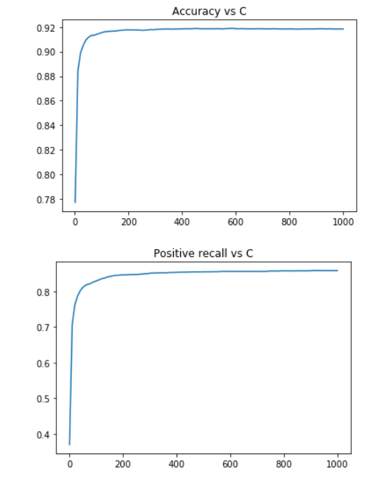
Results

Slide 14
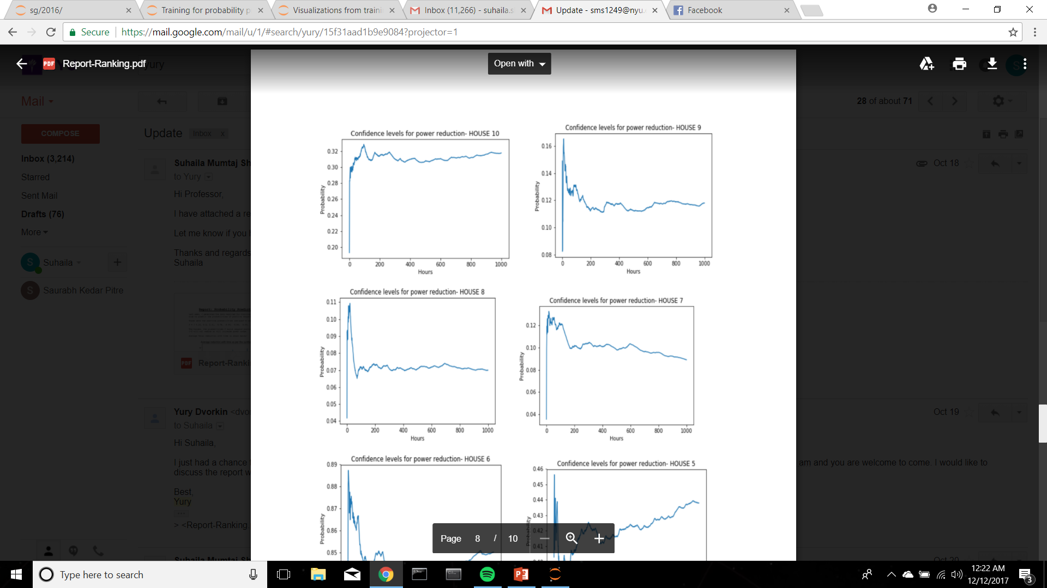
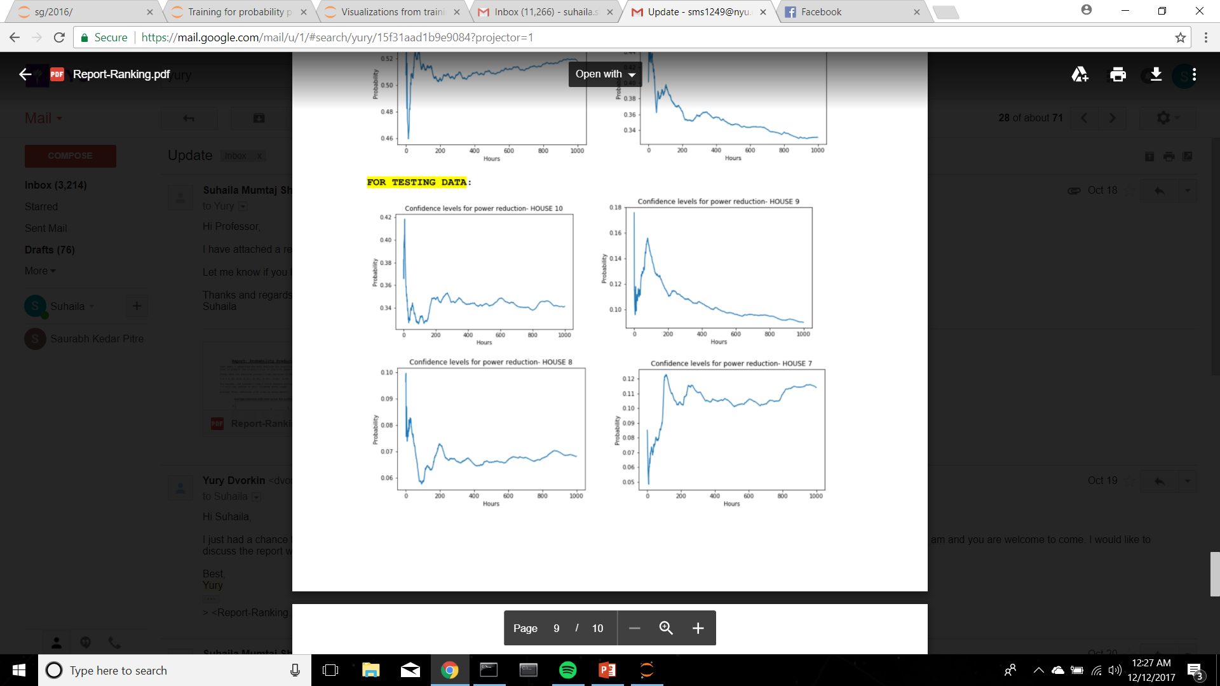
Results
[0.32 0.5 0.31 0.78 0.44 0.84 0.09 0.06 0.12 0.3]
Training data
Testing data

Slide 15
Optimization
Objective Function:
min (KL divergence + Over-Estimation)*(ICF) + (cost_so + cost_cust*(CI) + prev_fail )
P
Inconvenience Cost
Monetary Cost
Loss in time t-1
Subject to: 0≤ P(i) ≤ 1
Dr(i) ≤ P(max)

Slide 16
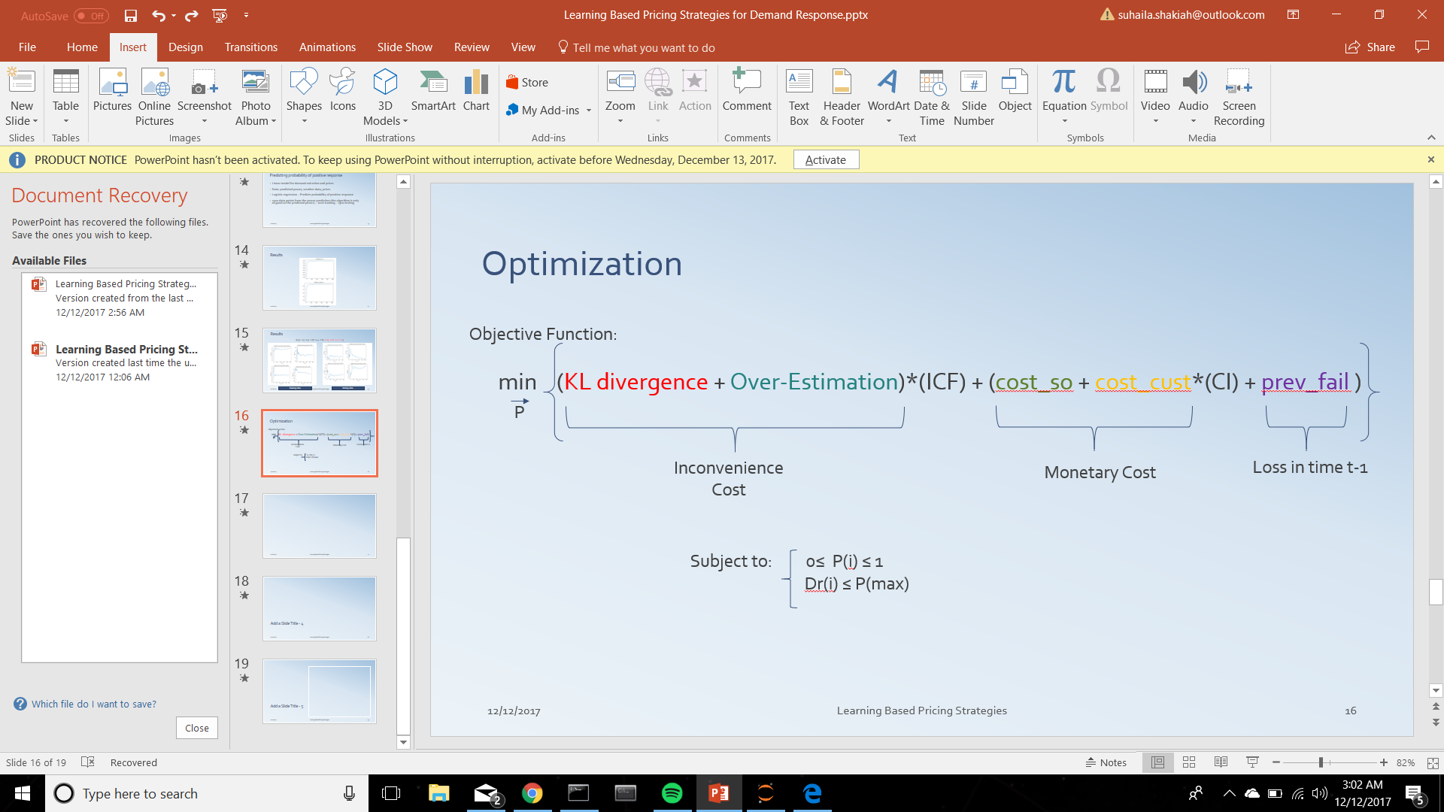
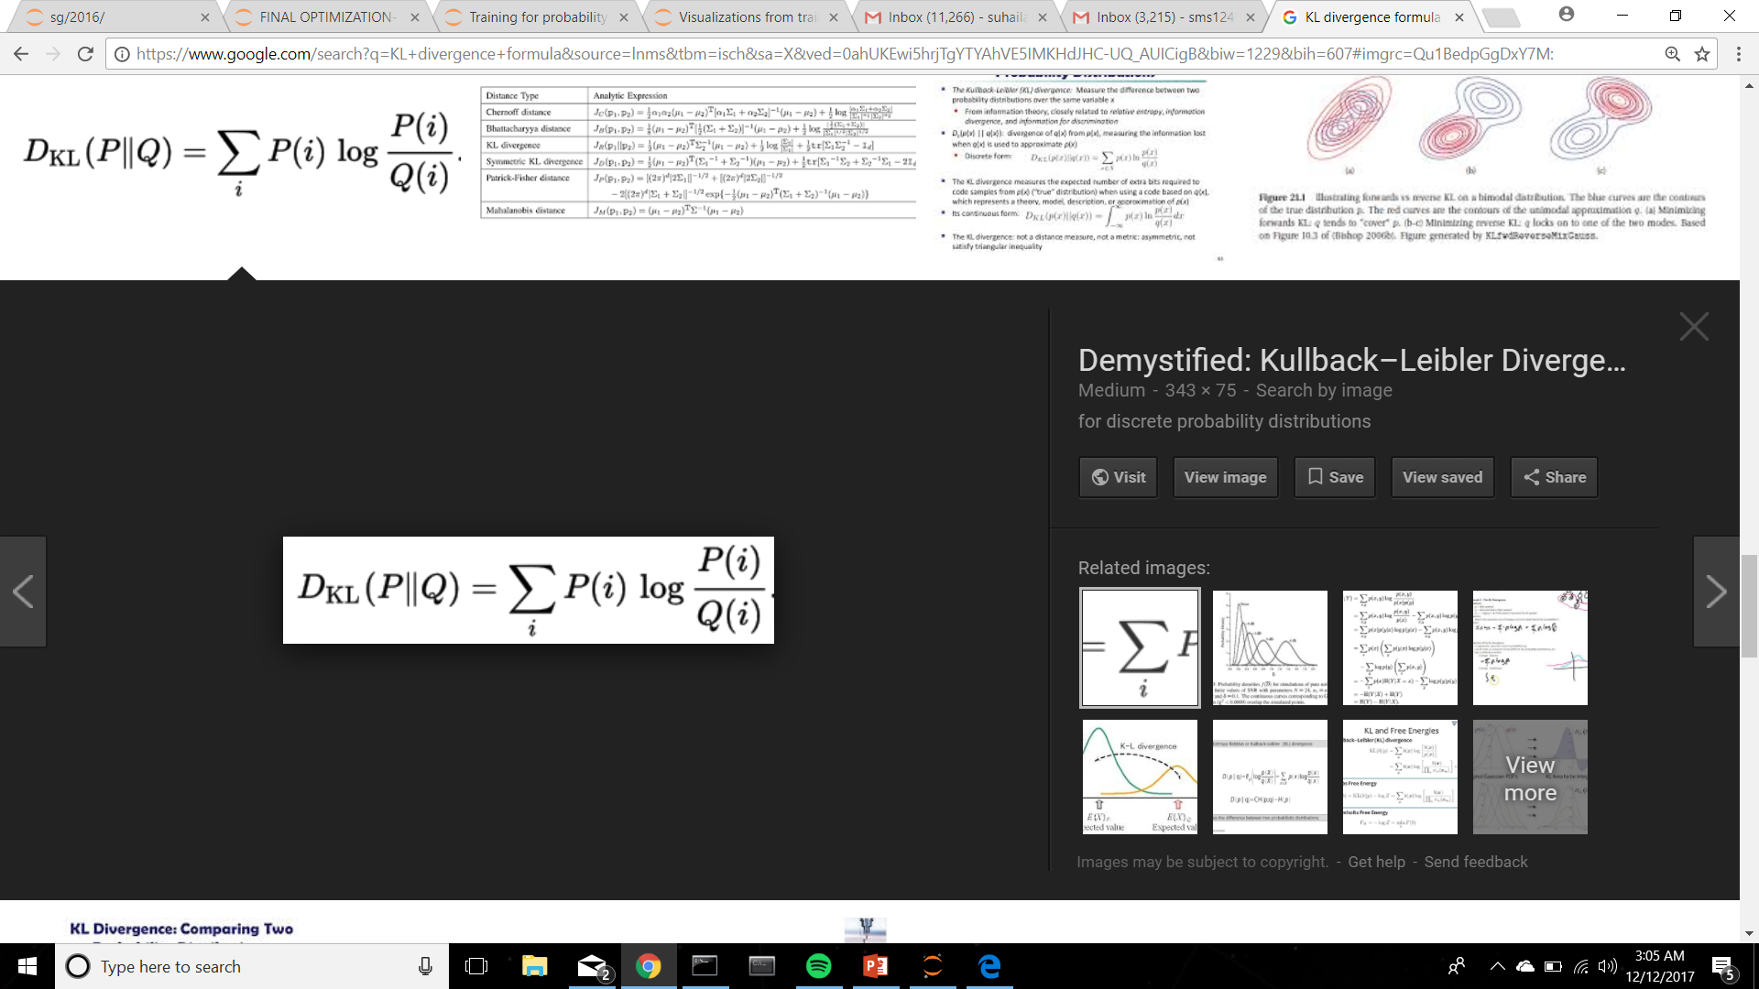
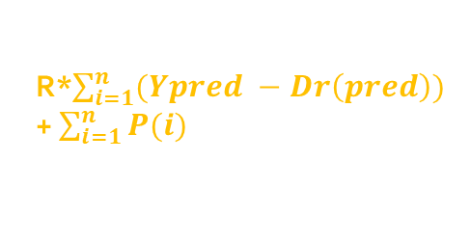
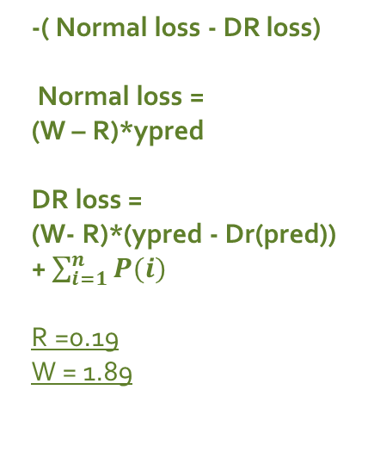
Distance between probability distributions
Dr(pred) – power(pred)
-( Normal loss - DR loss)
Normal loss =
(W – R)*ypred
DR loss =
(W- R)*(ypred - Dr(pred)) + $\sum_{i=1}^{n}{P(i)}$
R =0.19
W = 1.89
R*$\sum_{i=1}^{n}{(Ypred −Dr\left(pred\right))}$+ $\sum_{i=1}^{n}{P(i)}$
Dr(pred) – actual(pred) +
Loss(t-1)
Models
Linear model for reduction vs price
1. Dr = ap + b
Linear model for predicted probability vs price
2. Prob = kp + c

Slide 17
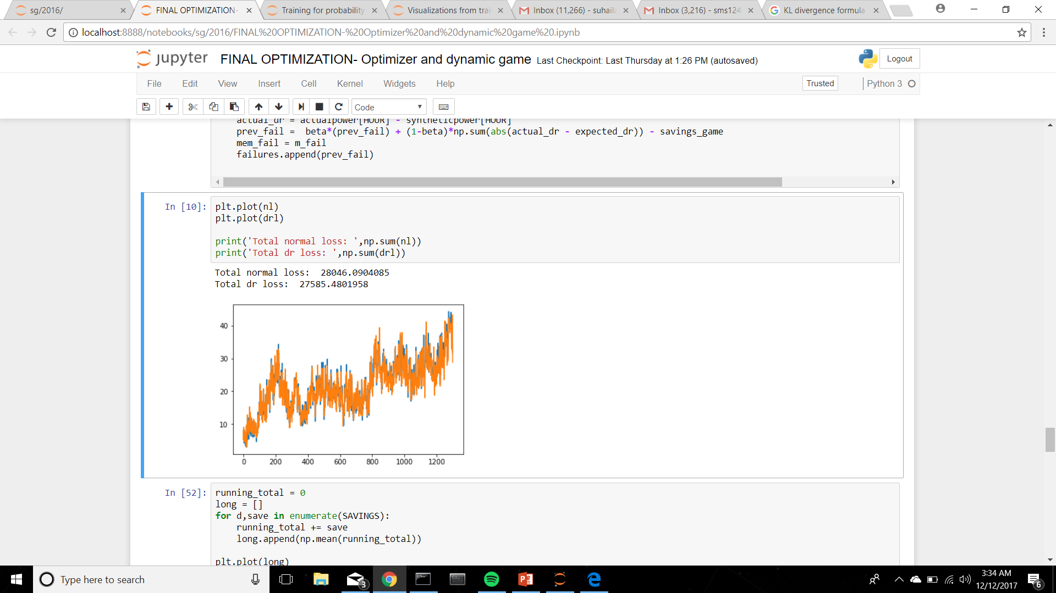
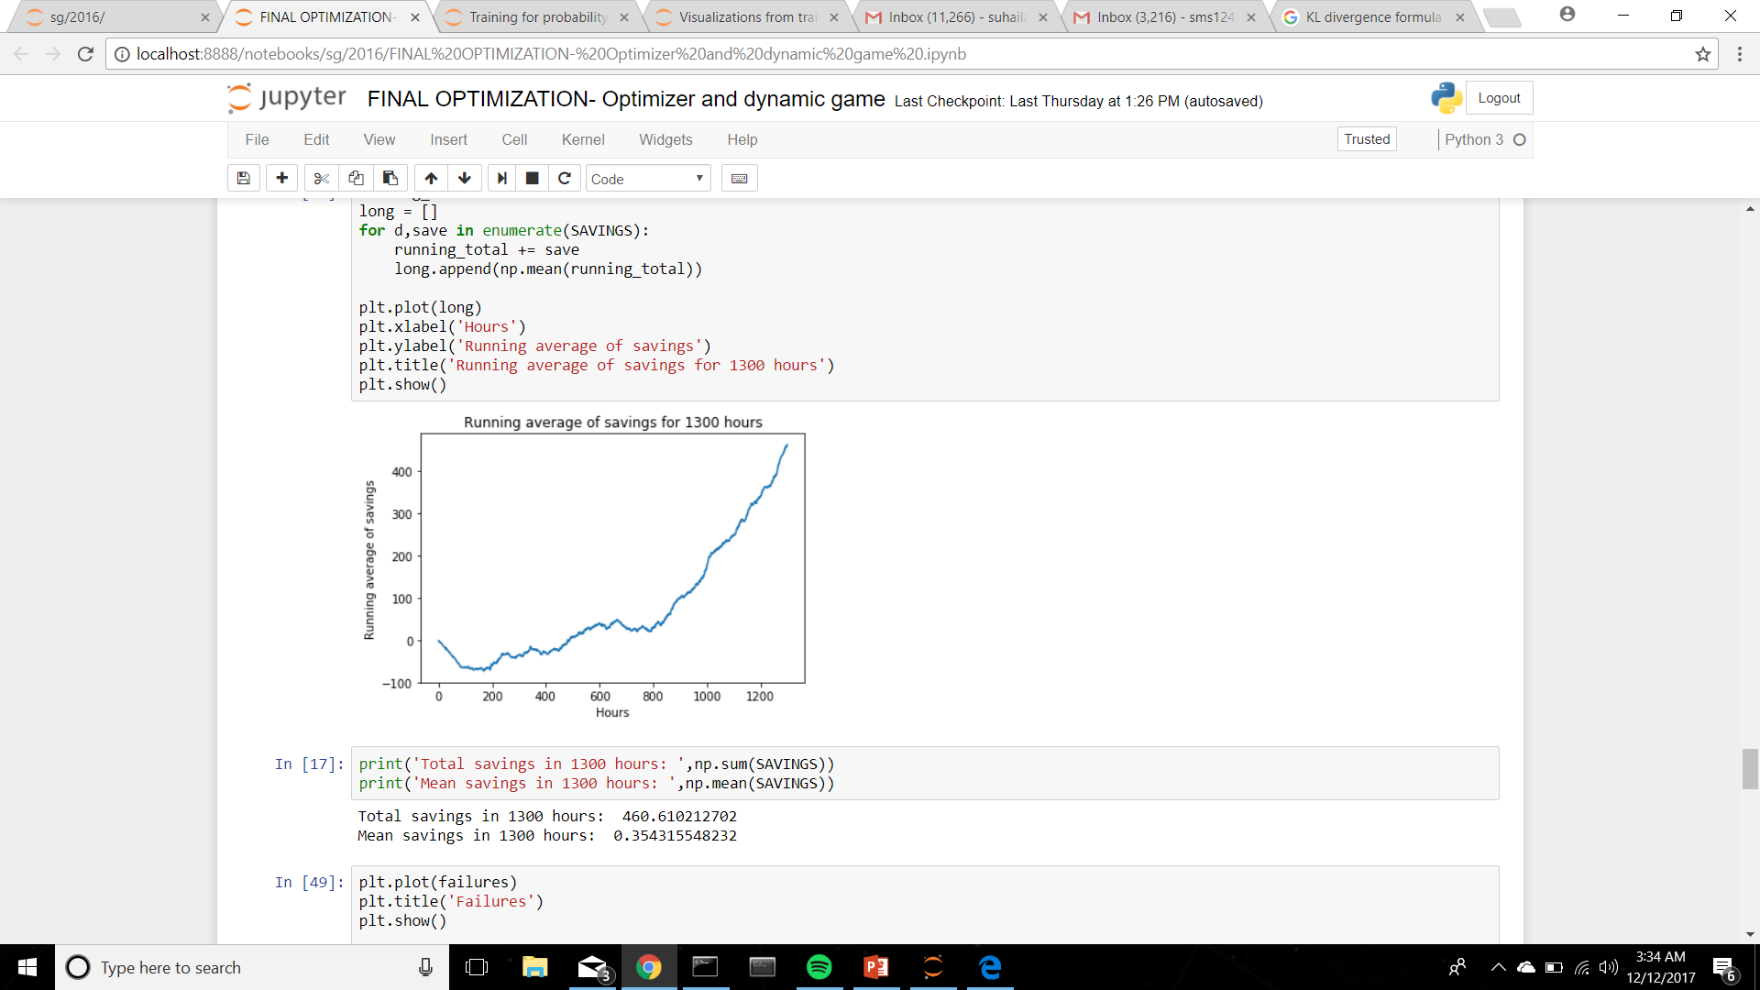
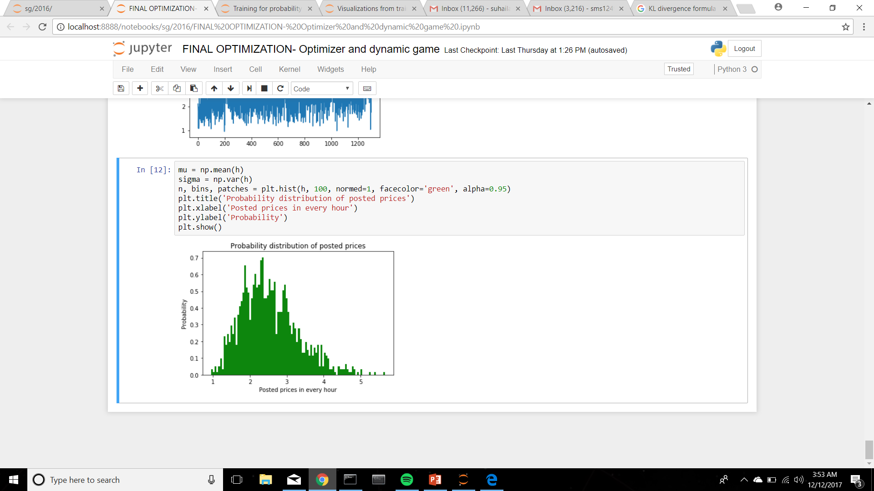
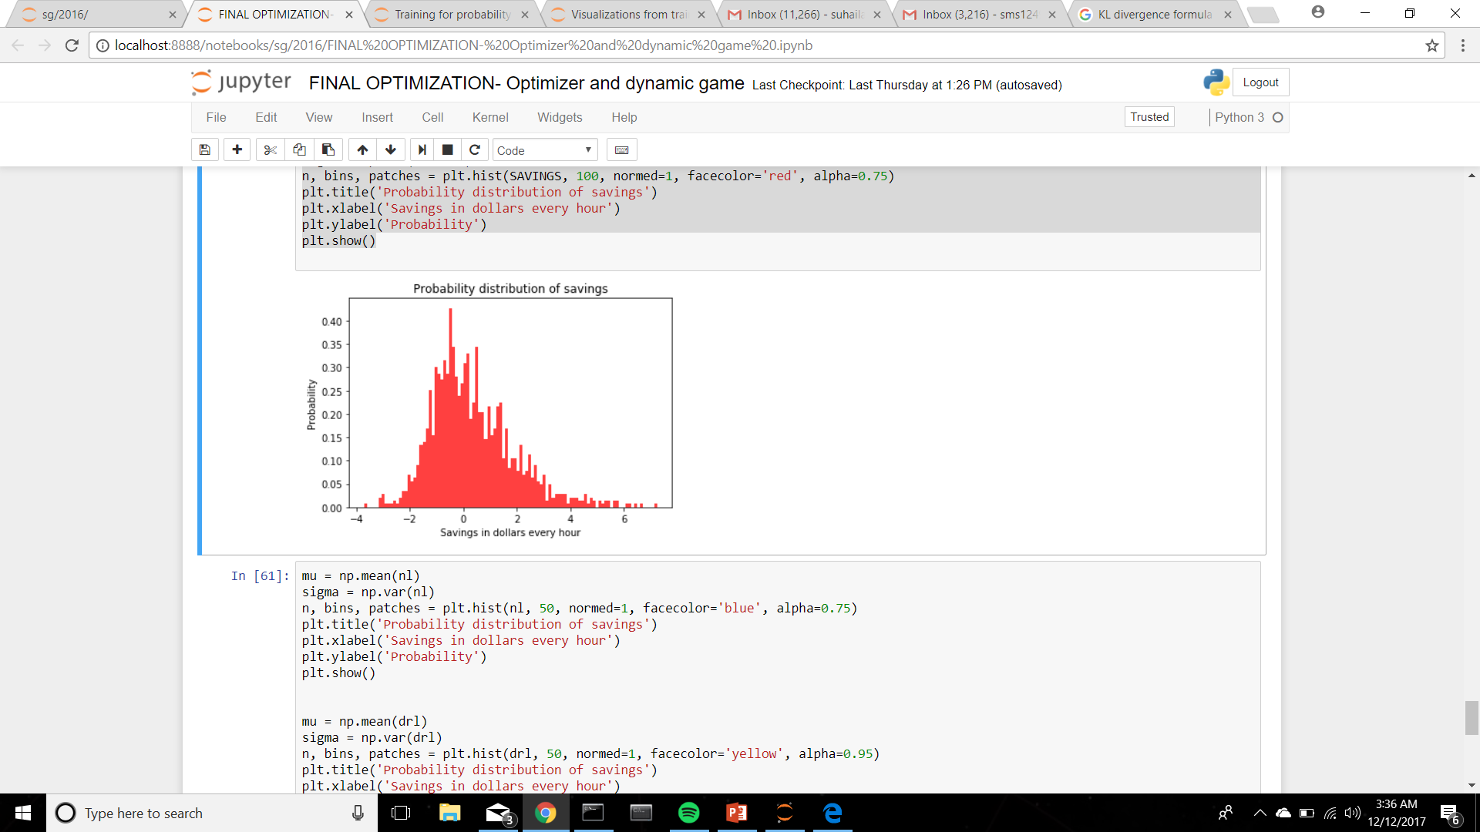
Results

Slide 18
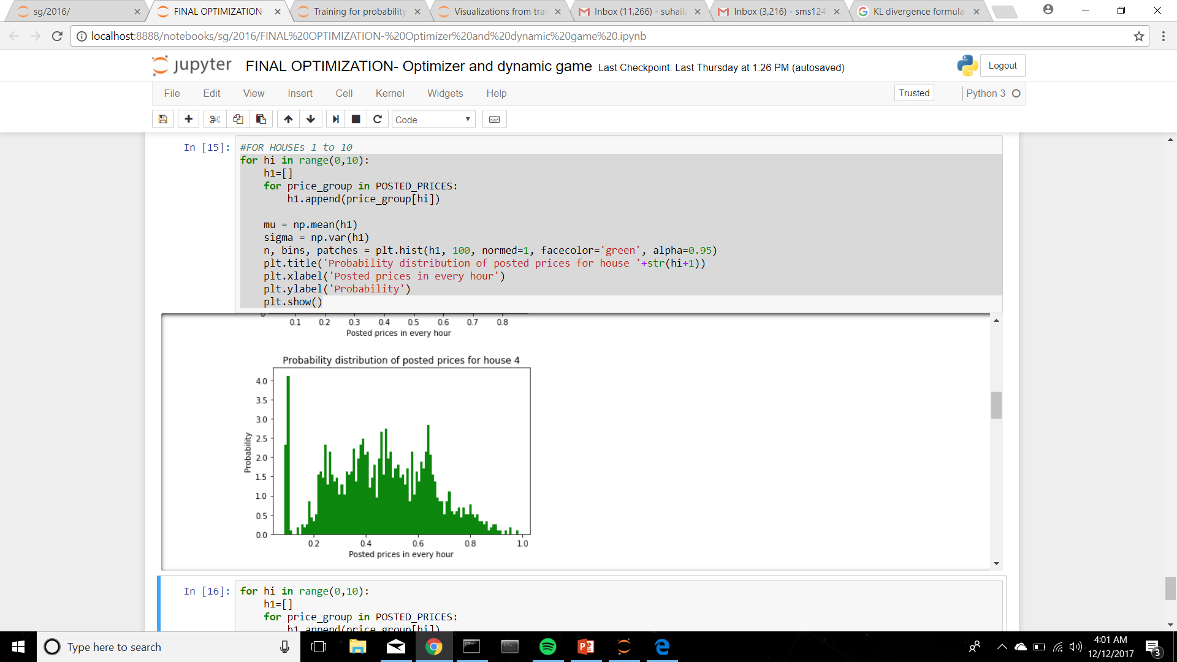
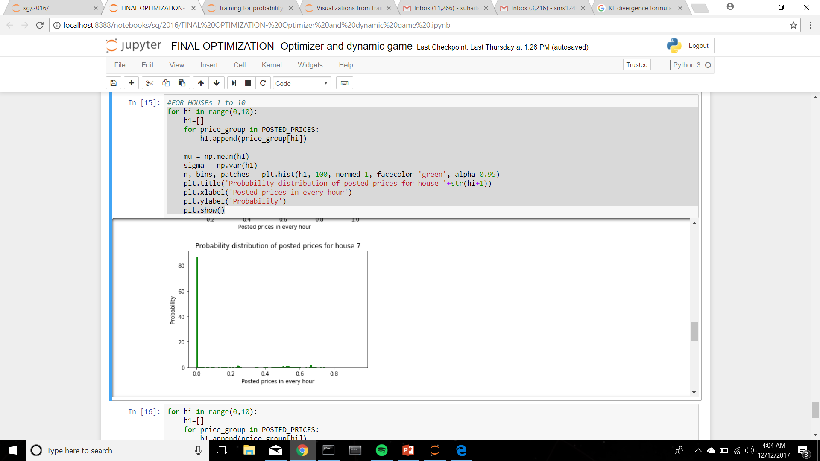
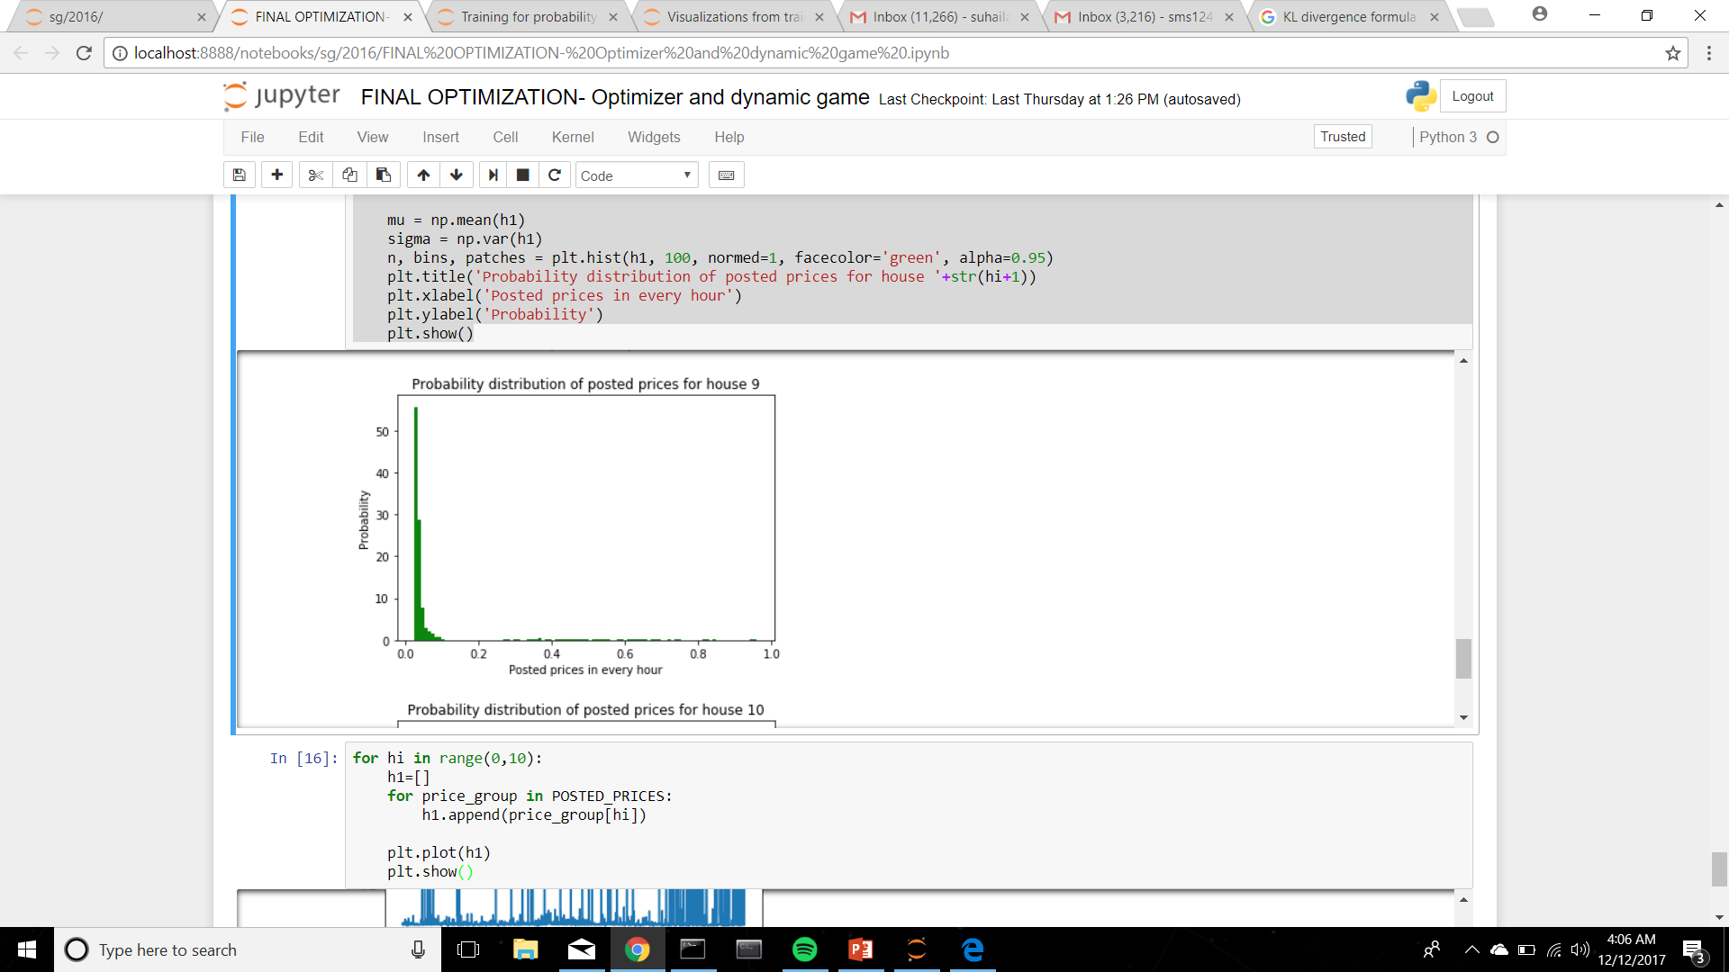
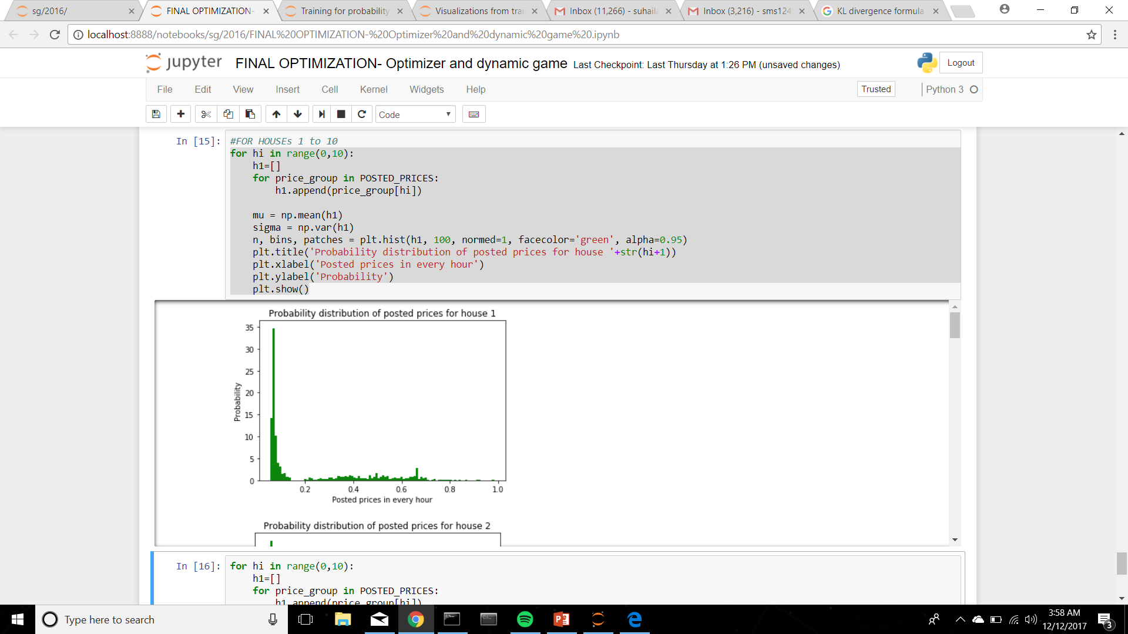
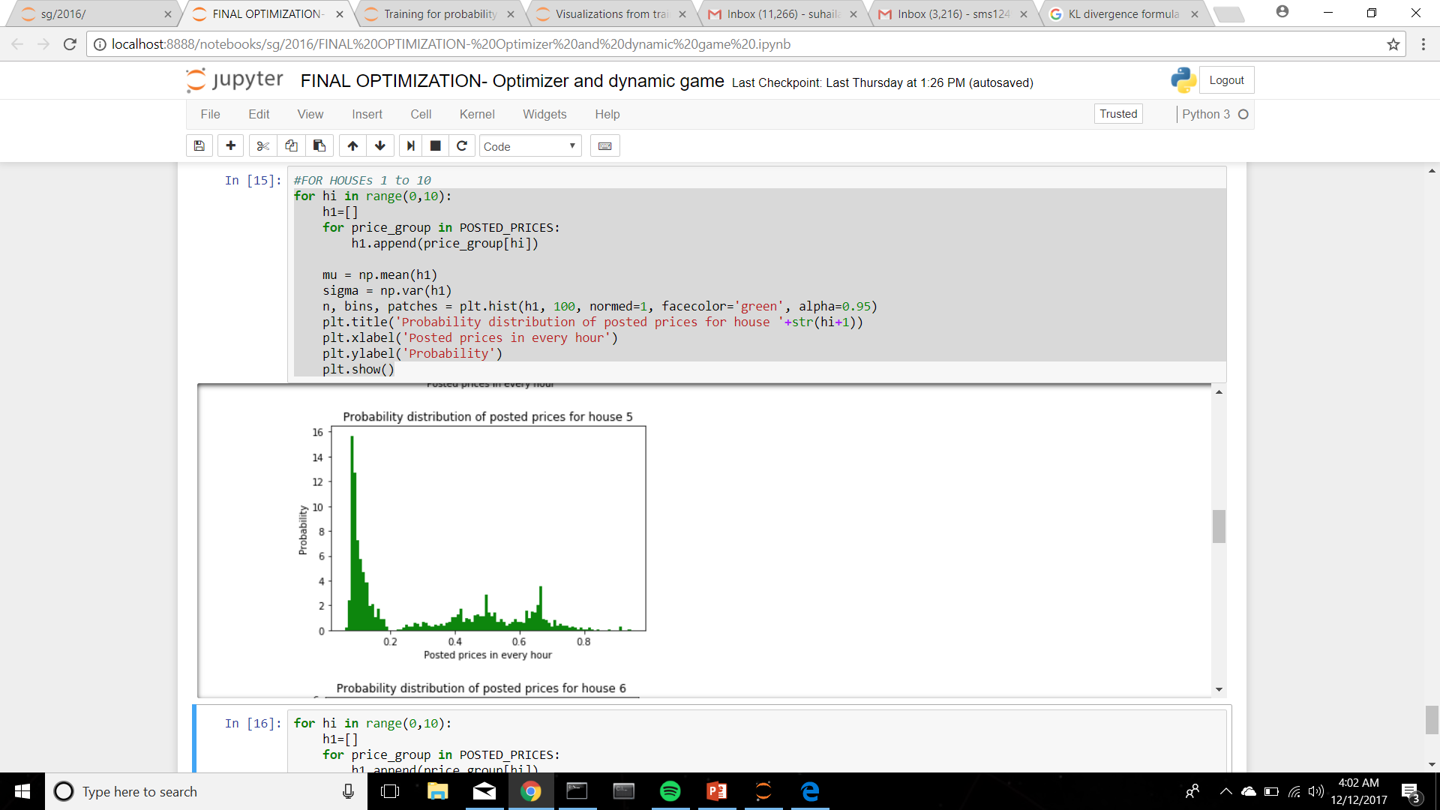
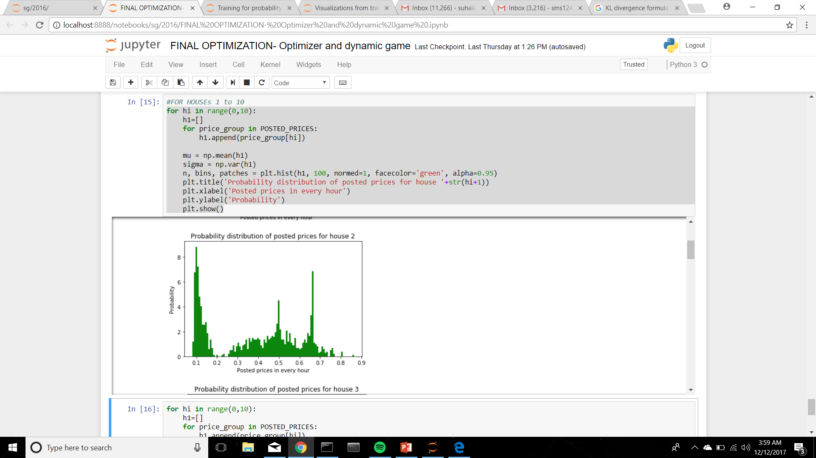

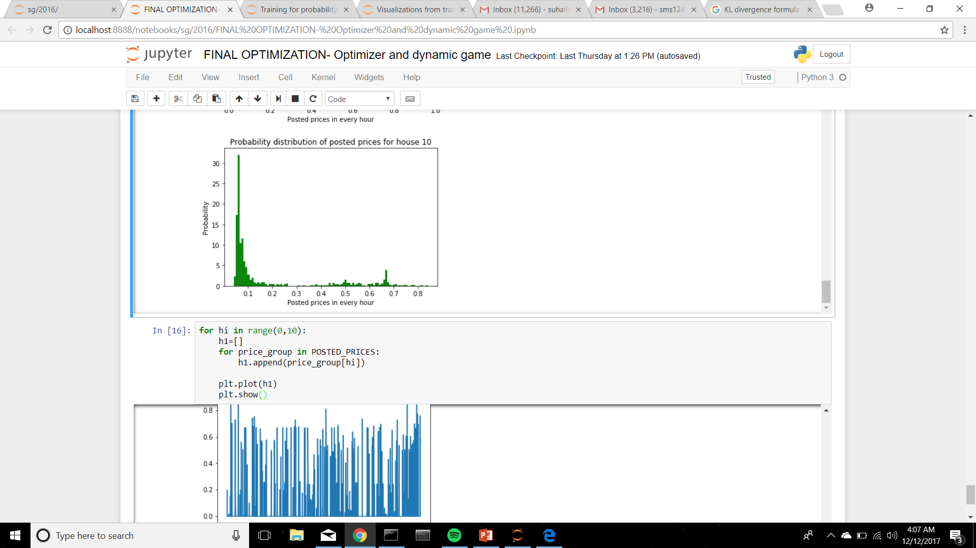
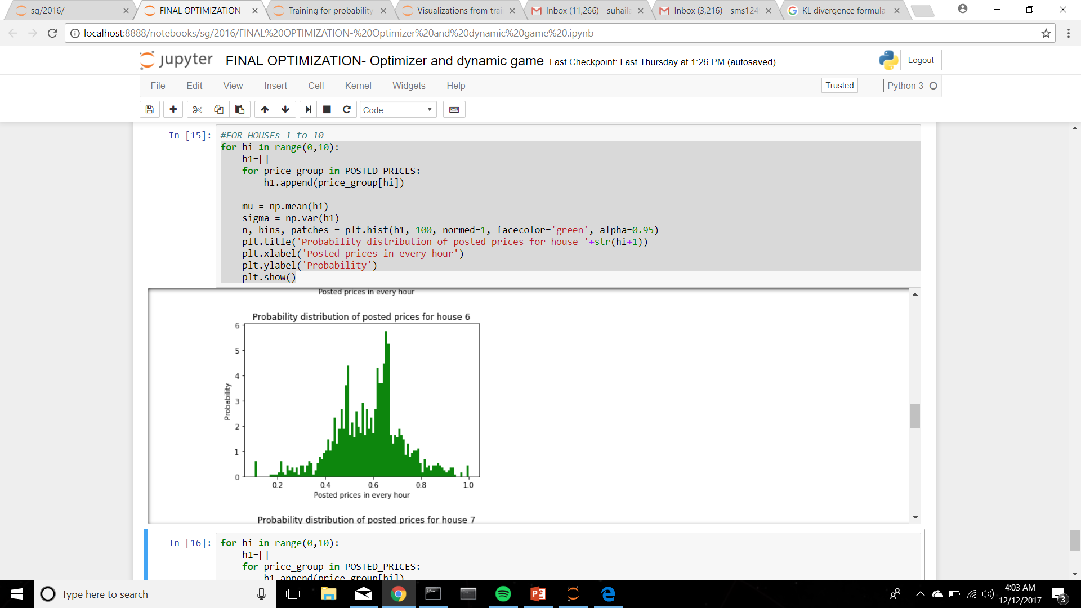
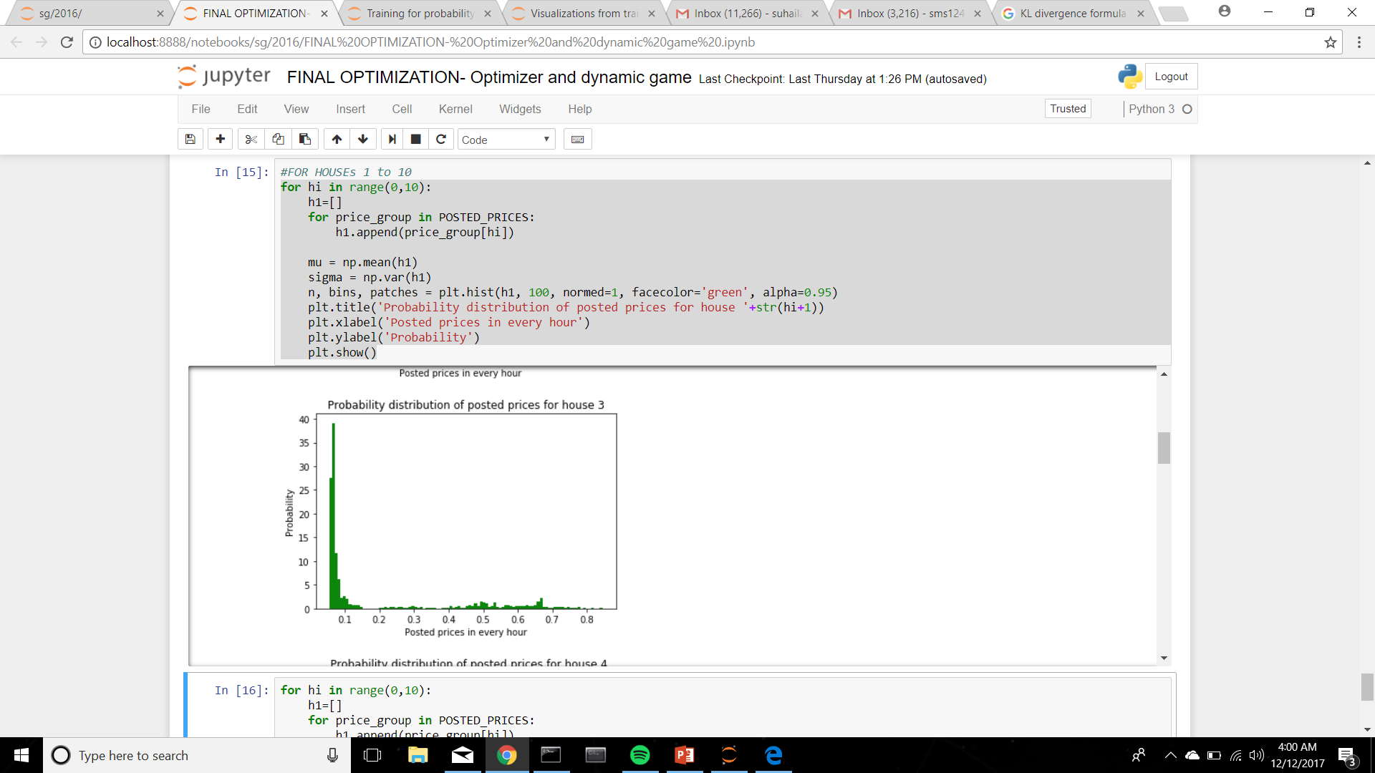
Results
[0.32 0.5 0.31 0.78 0.44 0.84 0.09 0.06 0.12 0.3]

Slide 19
Questions?

Slide 20
Thank you

